Slide 1
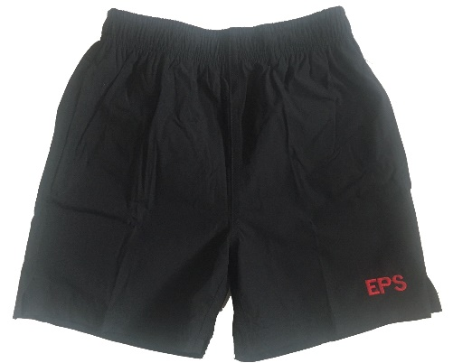
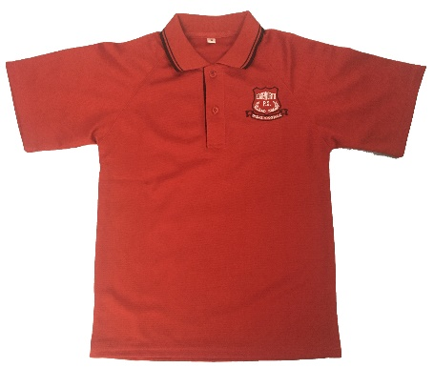
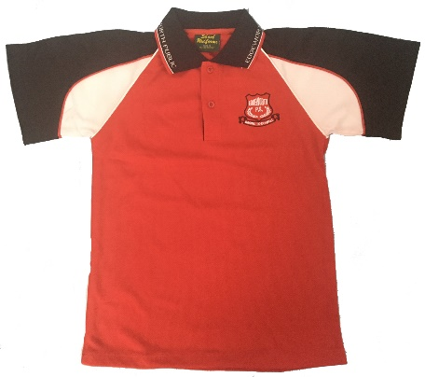
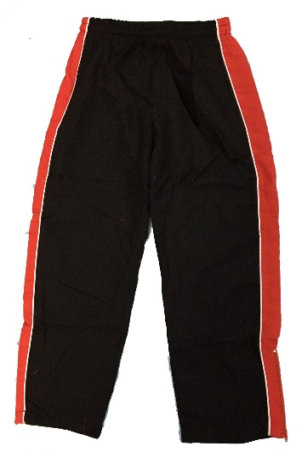
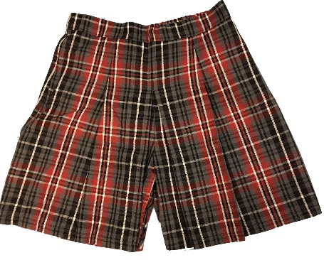
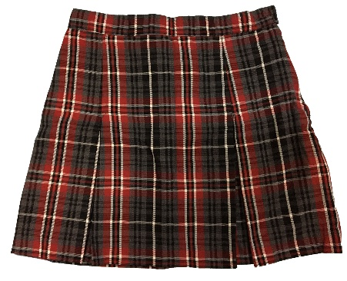
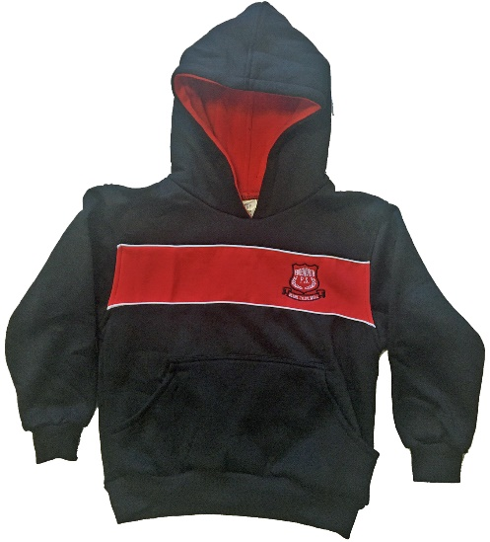
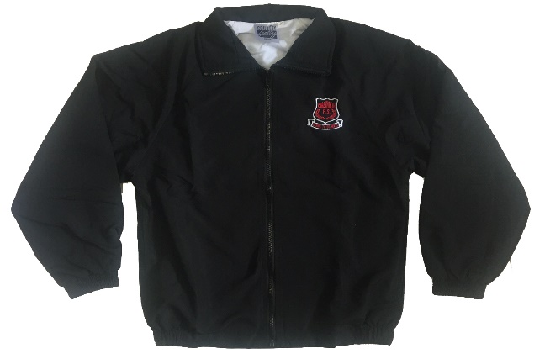
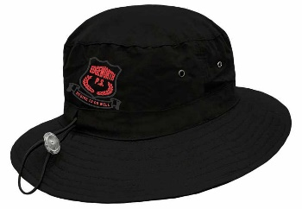
OPENING HOURS
Mon 2.30-3.30pm
Tue 2.30-3.30pm
Thu 8.30-9.30am
Everyday Polo Shirt | $34
Sports Polo Shirt | $33
Sports Shorts Stretch Microfibre | $26
Girls Tartan Skorts | $45
Girls Tartan Skirt | $45
Jacket Microfibre | $59
Trackpants Microfibre | $33
Hooded Jumper | $51
Bucket Hat | $15
Socks Red | $4
Online ordering – collect from Uniform Shop
www.countryfeelinguniforms.com.au
Country.feeling@bigpond.com
0414 651 211

